Slide 1
Triangulation Using
Computer Vision
Cot5930: Introduction to Robotics
Dr. Ravi Shankar
By
Huajin Ariel Qu & Charles Perry Weinthal

Slide 2
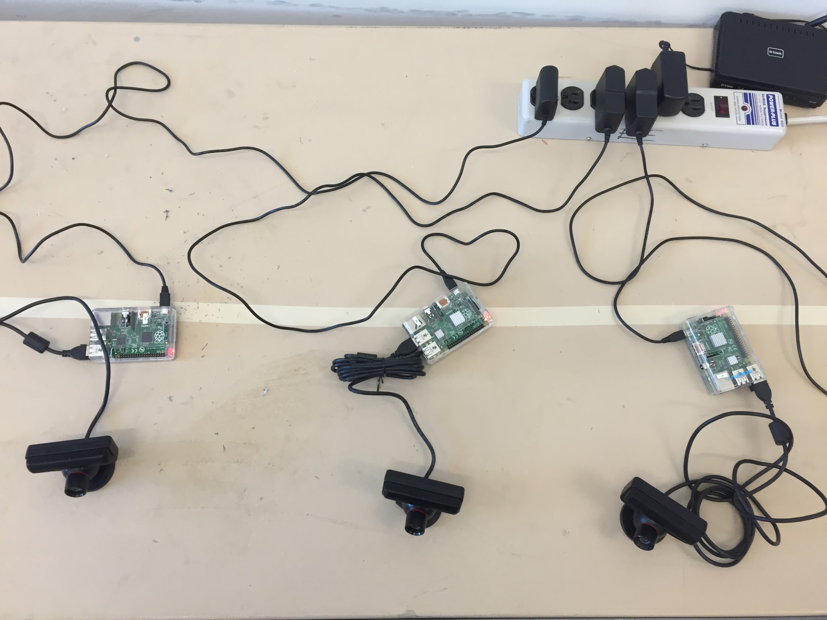
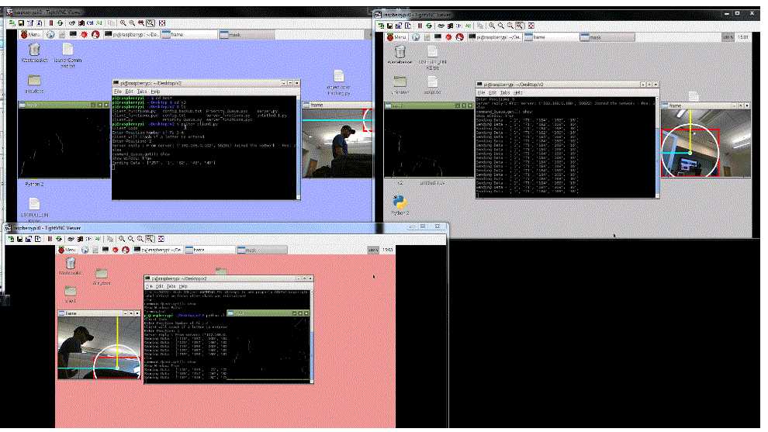
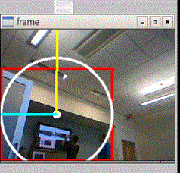
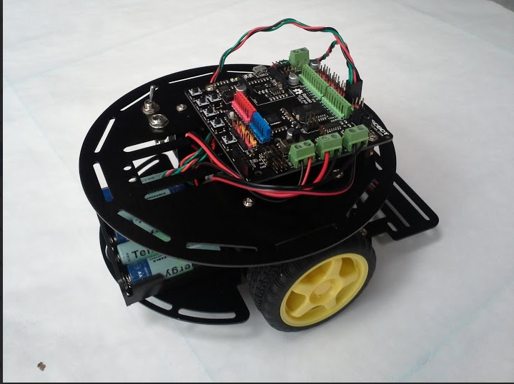
Overview
Four Raspberry Pi have been configured with USB WebCams [Camera Computational Unit -- CCU] to view the movement grid, these four units then report via WIiFi connections to a main computational and control Unit. A remote data connection transmits the robot location as viewed from four cameras. Each camera on provides the distance from it and the perceived angle. From this perceived angle triangulation is then used to compute the actual location of the robot. The distance is calculated using a known object size, the robot or test ball, and based on that size a perceived distance is calculated the angle is calculated using distance and its actual position offset from the center axis of the camera image. The main unit will then compute the distance using triangulation and command the Robot to move via a Bluetooth interface.

Slide 3
Network Communications
Implemention of TightVNC[1], a virtual remote desktop server for the Raspberry Pi, this code enables the user to control the remote Raspberry Pi via the web browser. By using a TightVNC / WiFi remote console, wires are not necessary to control the Raspberry Pi console, also this verifies the data link between the main server and the camera remotes.

Slide 4
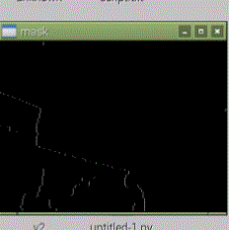
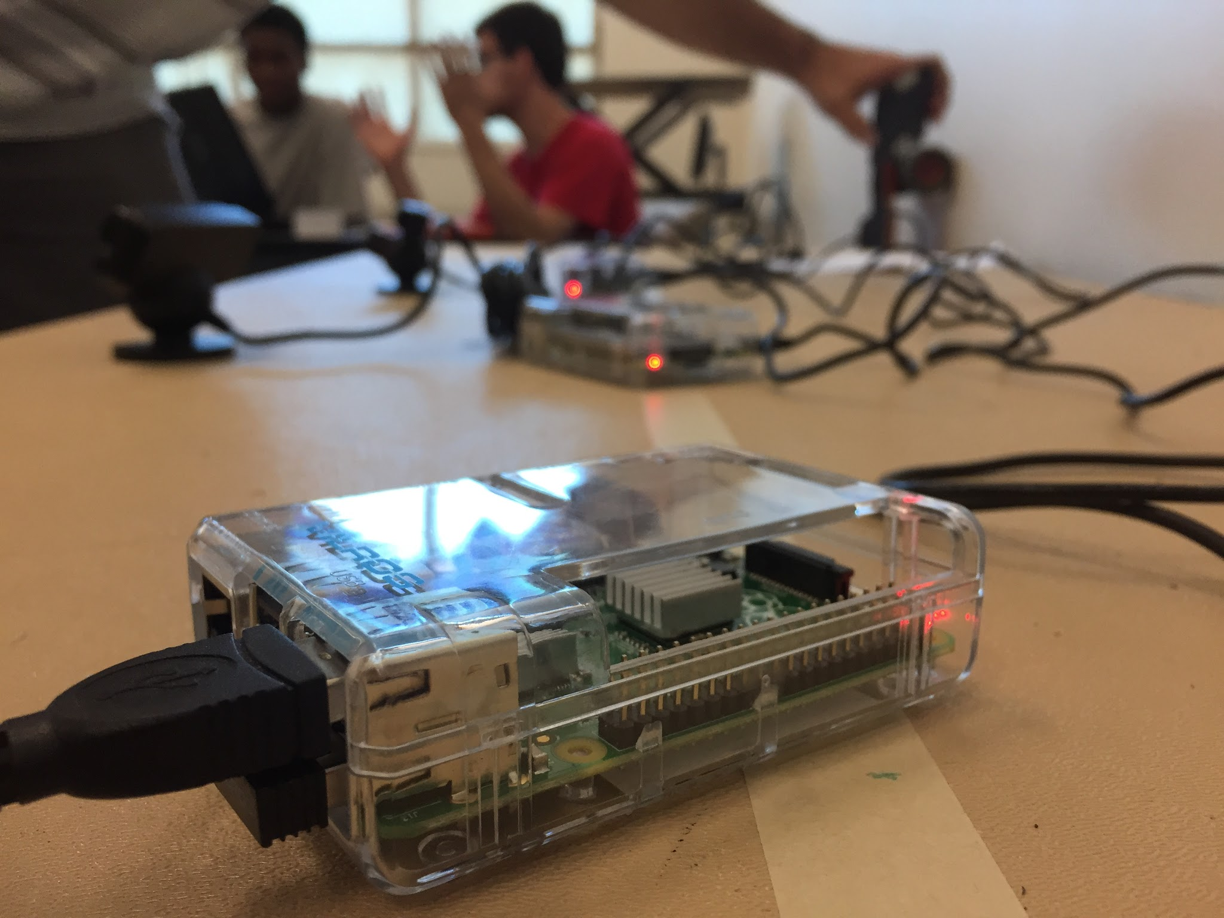
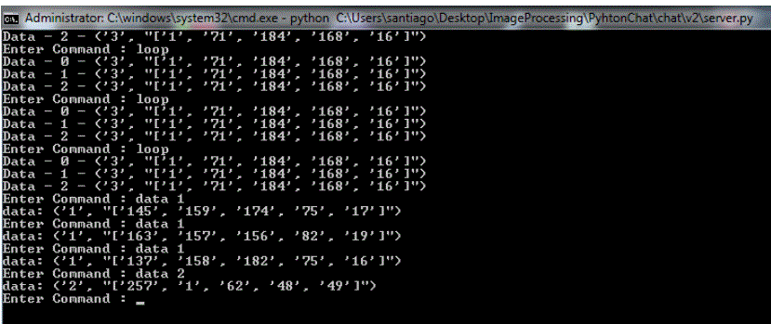
Computer Vision
Four Raspberry Pi units interpret the image using an edge detection algorithm implemented in the Python OpenCV[2] library. The edge detection resultants is then used to calculate the object’s screen location & size. Using the known size of the object, the object’s distance is calculated and angle can be derived. Each remote data connection transmits the robot location as viewed from four cameras. Each camera unit provides the distance from it and the perceived angle. From this perceived angle triangulation is then used to compute the actual location of the robot. The distance is calculated using a known object size, the robot or test ball, and based on that size a perceived distance is calculated the angle is calculated using distance and its actual position offset from the center axis of the camera image.

Slide 5
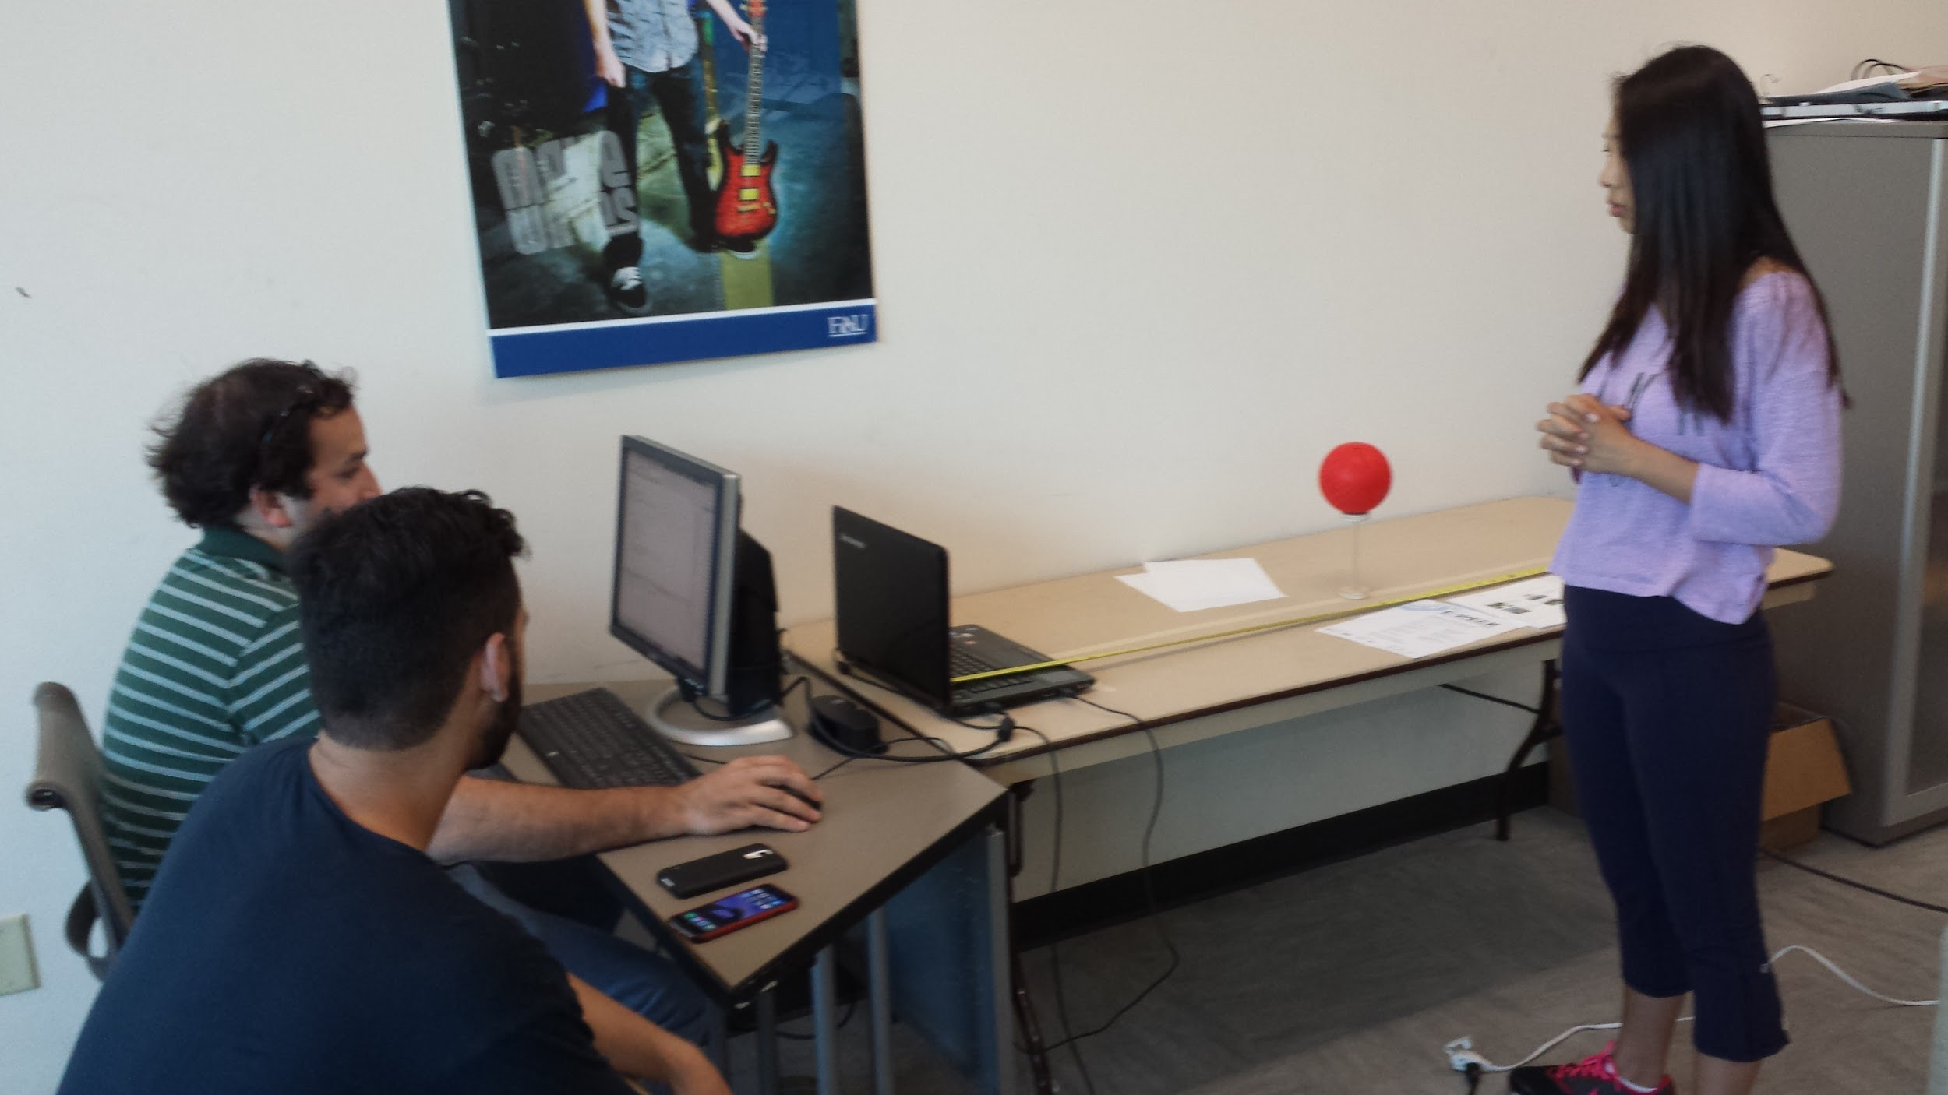
What the Camera Really Sees
Computer Vision is based on one CRITICAL DATUM: FOCAL LENGTH
The focal length calculation for the cameras. [3]
distance to object (mm) * object height (pixels) * sensor height (mm)
focal length (mm) = ---------------------------------------------------------------------------
real height of the object (mm) * image height (pixels)

Slide 6
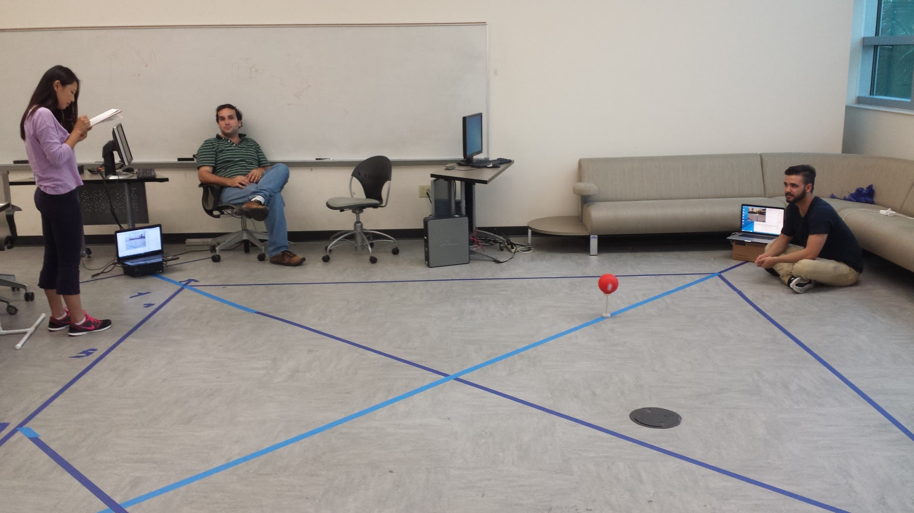
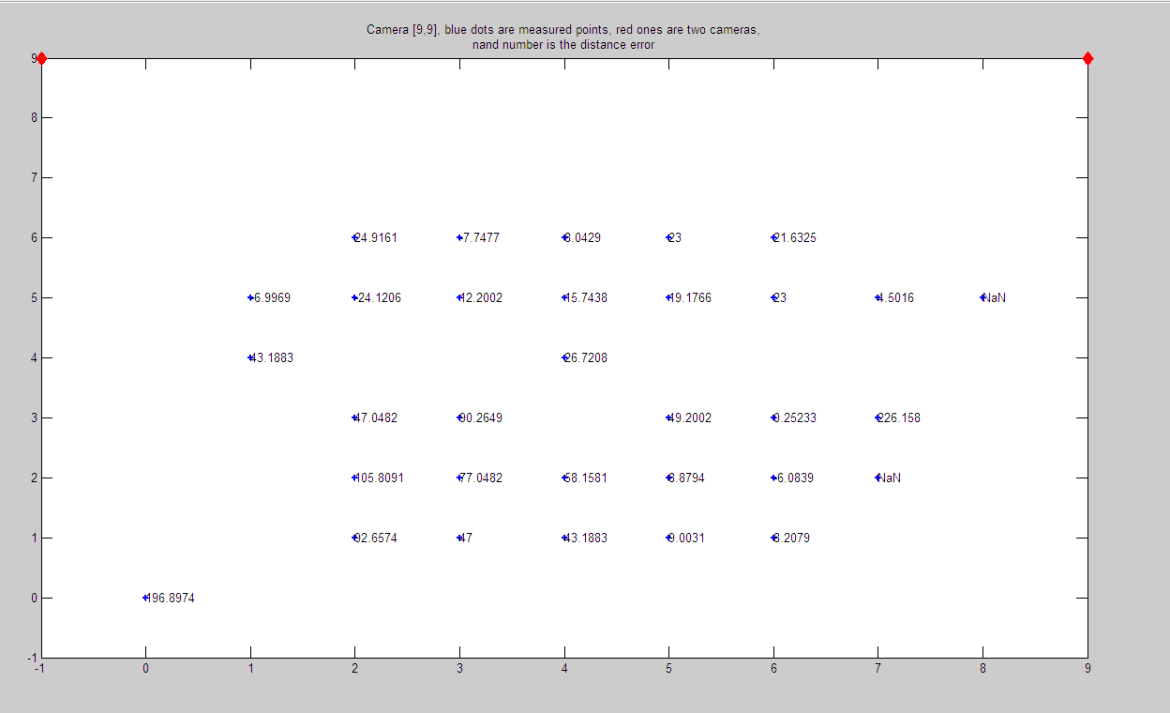
Interpreting the Data:
Mapping the Camera Lens
Mapping the vision camera system error grid.
Inexpensive off-the-shelf cameras which have lens irregularities and asymmetrical characteristics after plotting and measuring the resulting apparent distance on the camera. Corrections will be derived using a system of equations or a simple array matrix based on the robots location. This will reduce the error issues caused by the camera's lens irregularities.

Slide 7
Interpreting the Data:
Mapping the Camera Lens
After Each Raspberry Pi transmitted the location information to the main unit, it does the coordinating and the final calculations for the robot location in most cases the cameras will see the actual robot, if the robot is at perceived angles >+/-40 degrees will the robot be out of view from a camera. After carefully mapping out the data the cameras determination of distance was surprisingly accurate for the further away from the camera. This is effect is the result of asymmetrical lens, so the best range is further away from the camera.
After testing many USB cameras a Sony Playstation camera determined to be the most suitable for the Linux operating system. The camera was more reliable and had fewer correction issues then several other webcams, the cost difference is negligible compare to the reliability. of the data.
An easy to use and build camera mounting stand for the corners half inch PVC pipe. PVC pipe is it inexpensive, readily available and easy to work with.

Slide 8
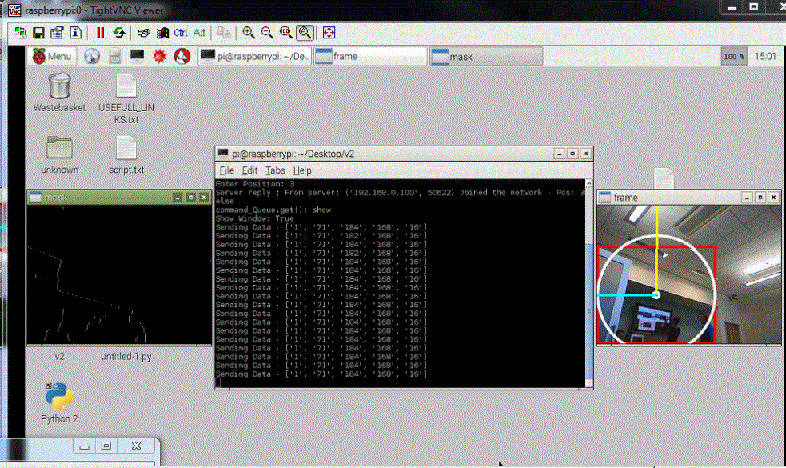

Slide 9
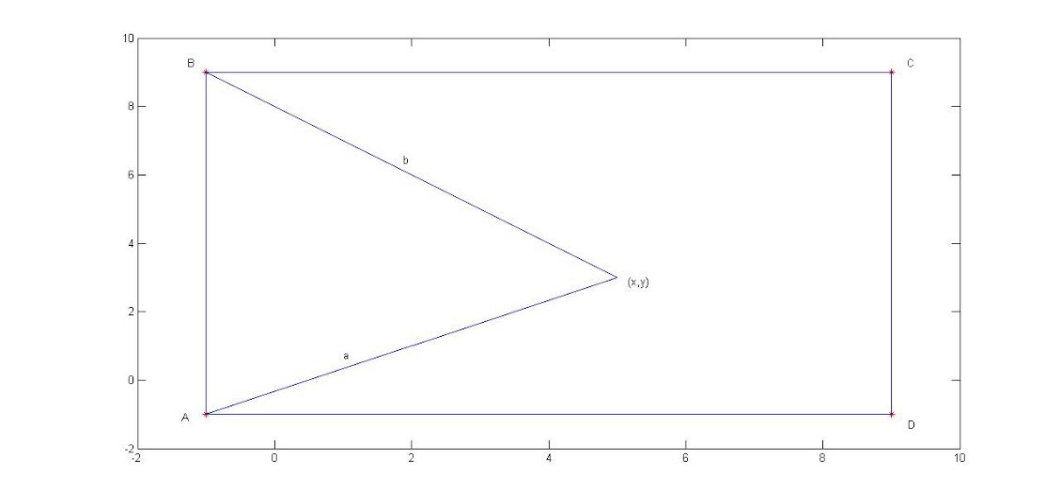
Where is the Robot?
Vectors, Coordinates and Angles

Slide 10
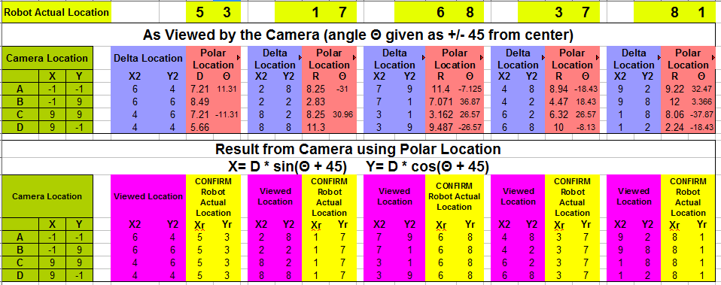
Testing the Results
The Cameras Provide:
Distance
Angles

Slide 11
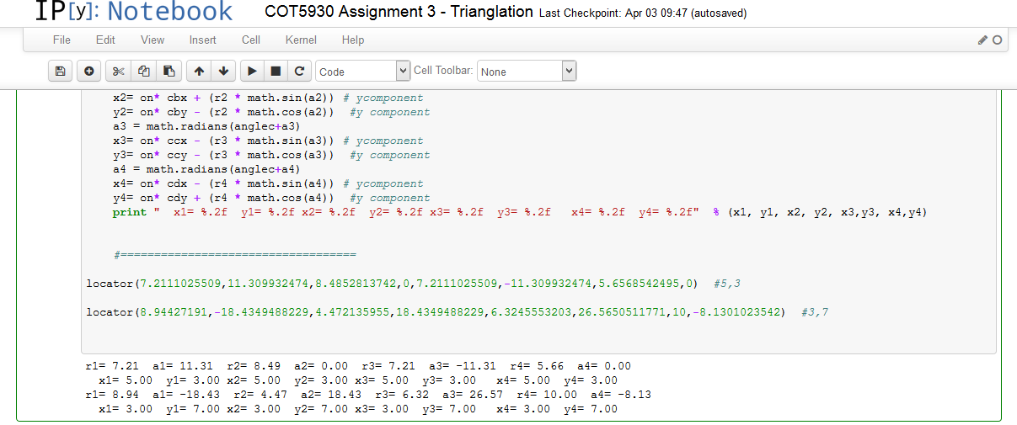
Python Code
The code expects 4 vectors and yields the Cartesian coordinates

Slide 12
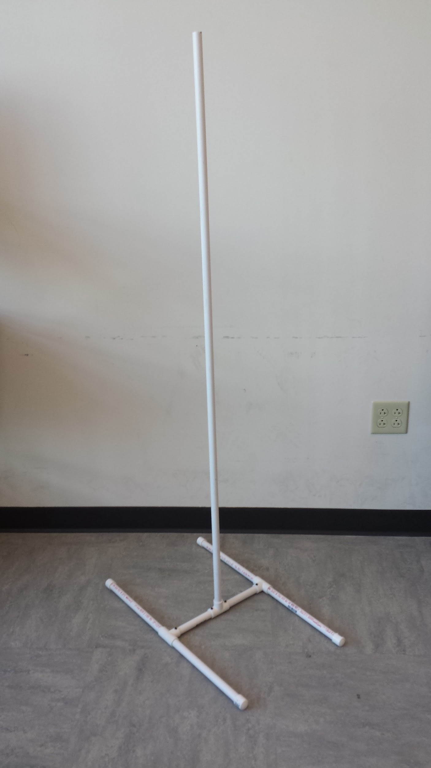
Camera Mounting Stand
An easy to use and build camera mounting stand for the corners half inch PVC pipe. PVC pipe is it inexpensive, readily available and easy to work with.

